Slide 1
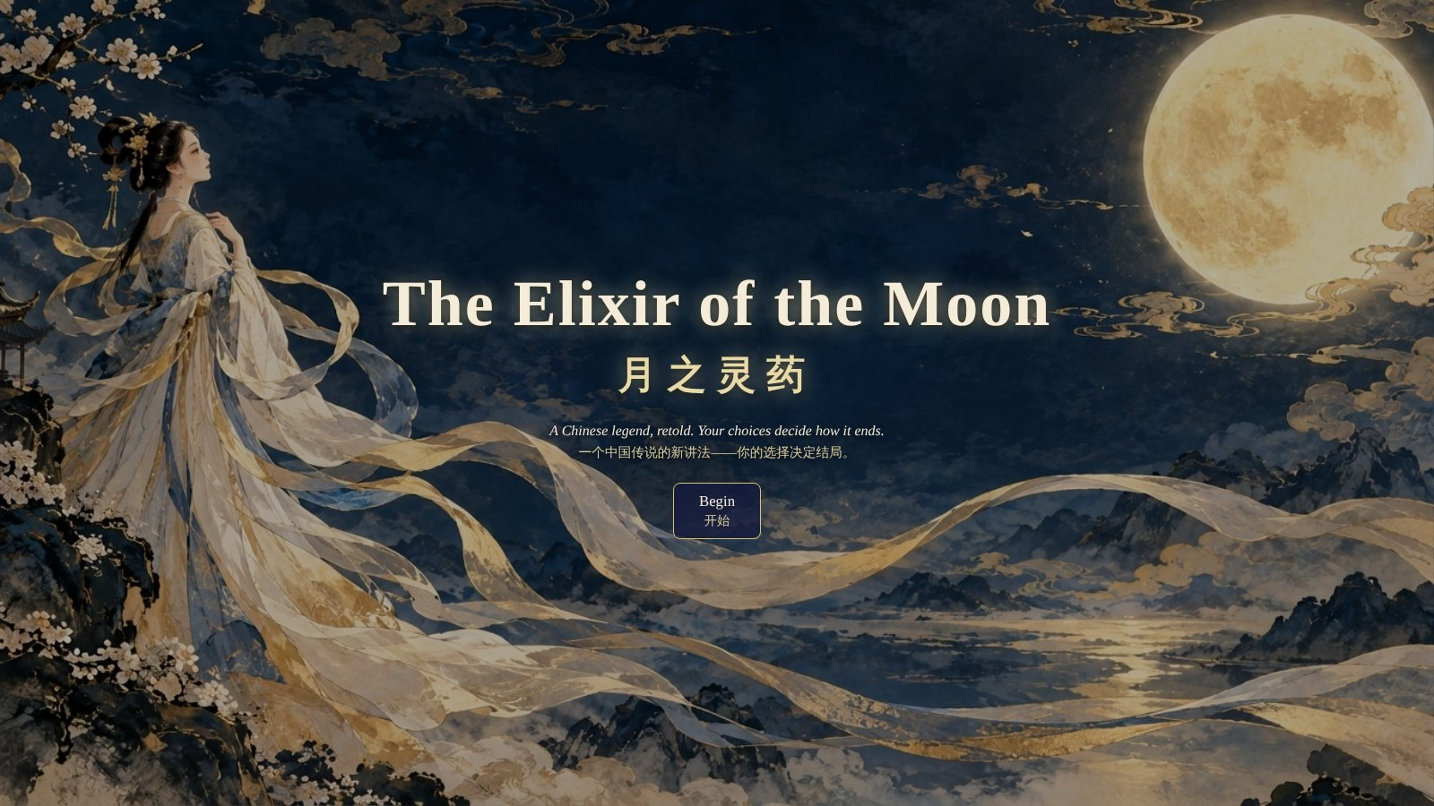
Ziqian Wang · CPS 2800 · Kean Cup AI Competition: Myths and Legends
Notes:
Hi everyone, my name is Ziqian Wang. My project is a small web game called "The Elixir/ɪˈlɪksə(r)/ of the Moon". It is based on a famous Chinese legend: the story of Chang'e, the lady on the moon. In this game, you are Chang'e, and your choices decide how the story ends.

Slide 2
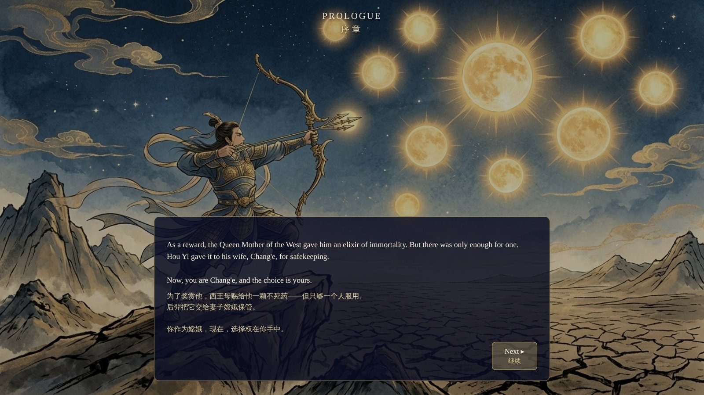
PLAY · 1 OF 5
The story begins
Ten suns, one hero, and a magic medicine for only one person.
Notes:
The game starts with a short story. Long ago, there were ten suns in the sky. The hero Hou Yi shot down nine of them. As a reward, he got a magic medicine. If you drink it, you live forever. But there is only enough for one person. He gives it to his wife, Chang'e. Now you are Chang'e.

Slide 3
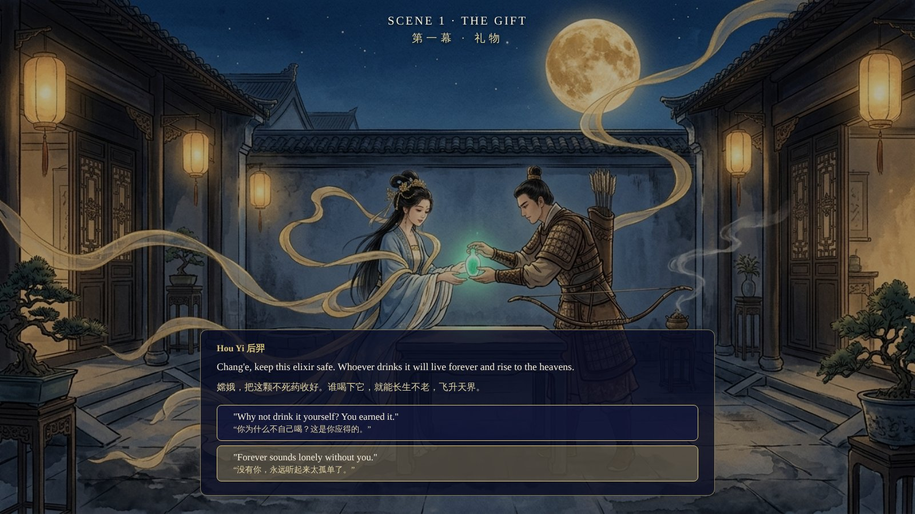
PLAY · 2 OF 5
Your first choice
Every scene has its own picture. All text is in English and Chinese.
Notes:
Then the player starts to make choices. Every scene has its own picture, and all the text is in English, with Chinese below it. In Scene 1, Hou Yi gives the medicine to Chang'e, and you choose what to say to him.

Slide 4
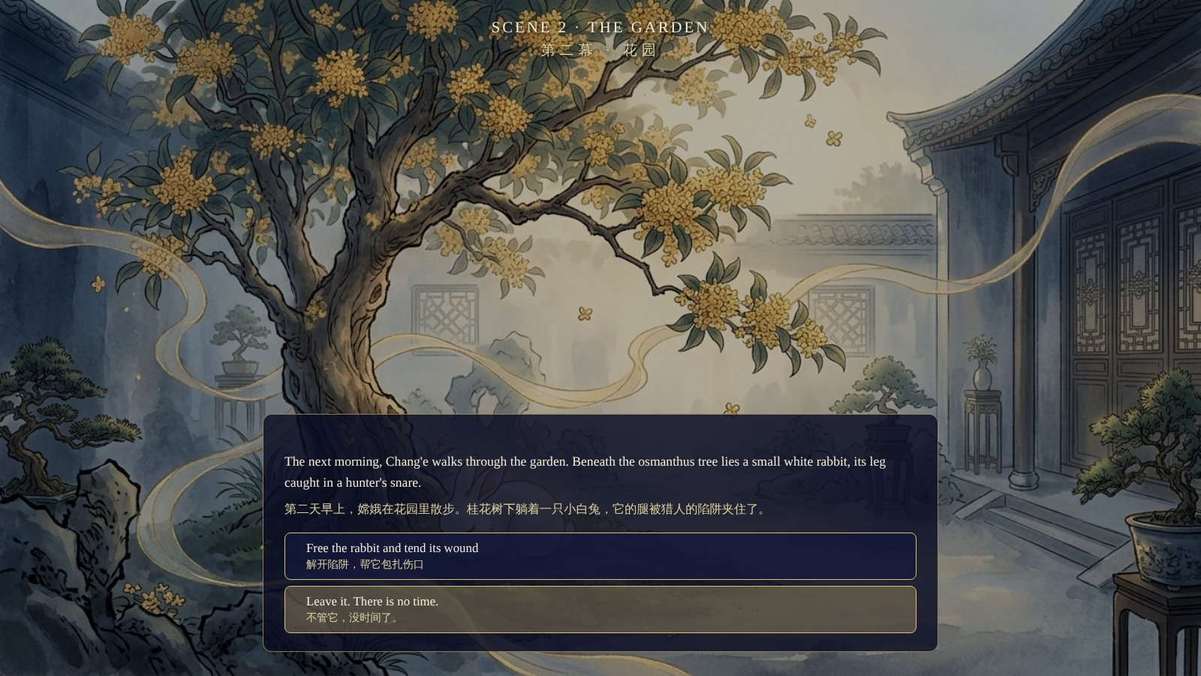
PLAY · 3 OF 5
A hurt rabbit
Help it, or walk away? This small choice matters at the end.
Notes:
In Scene 2, Chang'e finds a hurt white rabbit in the garden. You can help it, or walk away. I will help it. This choice looks small, but it is very important at the end.

Slide 5
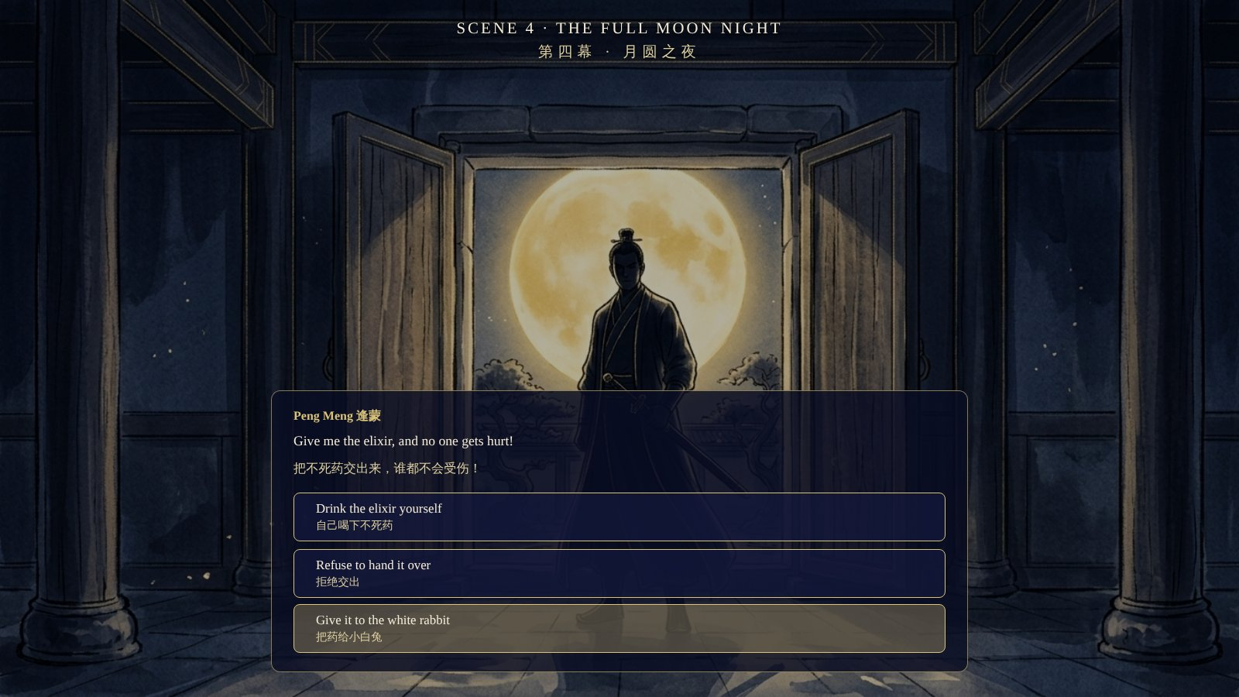
PLAY · 4 OF 5
The full moon night
Peng Meng wants the medicine. Because I saved the rabbit, a secret choice appears.
Notes:
Now I want to introduce Peng Meng. In the old legend, Peng Meng is Hou Yi's student. Hou Yi taught him how to shoot arrows. But Peng Meng is greedy. He wants the magic medicine for himself, so he can live forever.
In Scene 3, he asks Chang'e where the medicine is. Then, on the full moon night, Hou Yi is away, and Peng Meng breaks in with a sword/sɔːd/. He wants the medicine. Now you must choose: drink it, say no, or give it to the rabbit. The rabbit choice only shows up if you helped the rabbit before.

Slide 6
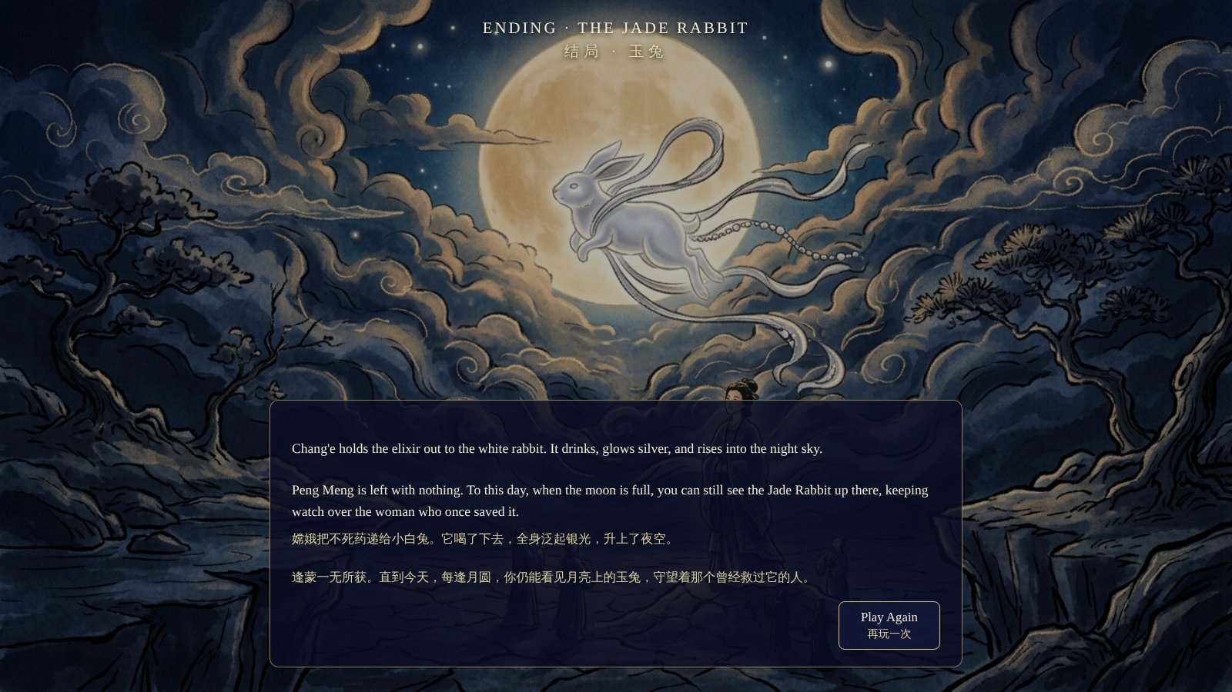
PLAY · 5 OF 5
The hidden ending
The rabbit flies to the moon and becomes the Jade Rabbit.
Notes:
If you give the medicine to the rabbit, you get the hidden ending. The rabbit flies to the moon and becomes the Jade Rabbit. In China, people say you can still see it on the moon today.

Slide 7
Four choices, four endings
Drink the medicine
Lady of the Moon: she lives alone on the moon
Say no, and you warned Hou Yi
Mortal Hearts: they grow old together
Say no, but no warning
Stolen Heaven: Peng Meng takes the medicine
Give it to the rabbit (if saved)
The Jade Rabbit: the hidden ending
Notes:
There are four endings in total. Two earlier choices decide which ones you can reach: did you save the rabbit, and did you warn Hou Yi about Peng Meng. So you can play again and try to find all of them.

Slide 8
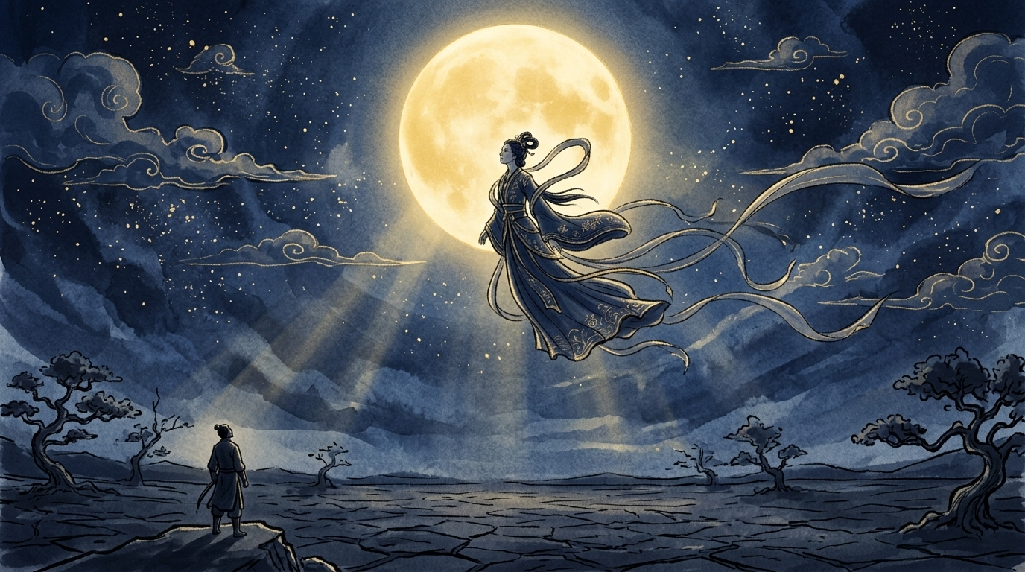
MY IDEA
What if Chang'e had a choice?
In the old story, she drinks the medicine and lives alone on the moon. This story is also why China has the Mid-Autumn Festival.
Far from home, I look at the same moon as my family.
Notes:
Why did I choose this story? In the old legend, Chang'e drinks the medicine and lives alone on the moon forever. I always asked myself: what if she had a choice? So I made the story into a game with choices. This story is also the reason for the Mid-Autumn Festival in China. On that night, families look at the full moon together. This is my first time living in the U.S., far from home. When I look at the moon here, it is the same moon my family sees. I wanted to share that feeling with you.

Slide 9



Three AI tools, three jobs
HOW I USED AI
Claude
ChatGPT
Gemini
Story idea, four endings, dialogue, and all the code
The cover picture
The other nine pictures
Notes:
I used three AI tools, and each one had a different job. Claude helped me plan the game and write the code. ChatGPT made the cover picture. Google Gemini made the other nine pictures.

Slide 10
WORKING WITH CLAUDE
FROM MY CHAT WITH CLAUDE
The first try was not perfect
Me: I want a dialogue game. The player has different choices, and different choices lead to different endings.
So I asked for changes:
Move the story intro into the game
Add Chinese under every line
Make the text show faster
Put the title in the middle
Claude: Here is the story outline and branching structure.
Scene 2, The Garden: help the rabbit → unlocks the hidden ending
Scene 3, The Apprentice: warn Hou Yi → he comes back in time
Four endings: Lady of the Moon · Mortal Hearts · Stolen Heaven · The Jade Rabbit
Notes:
First, I told Claude I wanted a game with choices and different endings. It helped me pick the story, plan the four endings, write the dialogue, and write the code in HTML, CSS, and JavaScript. The first version was not perfect, so I asked for changes. I moved the story intro into the game, added Chinese under the English, and some other changes.

Slide 11
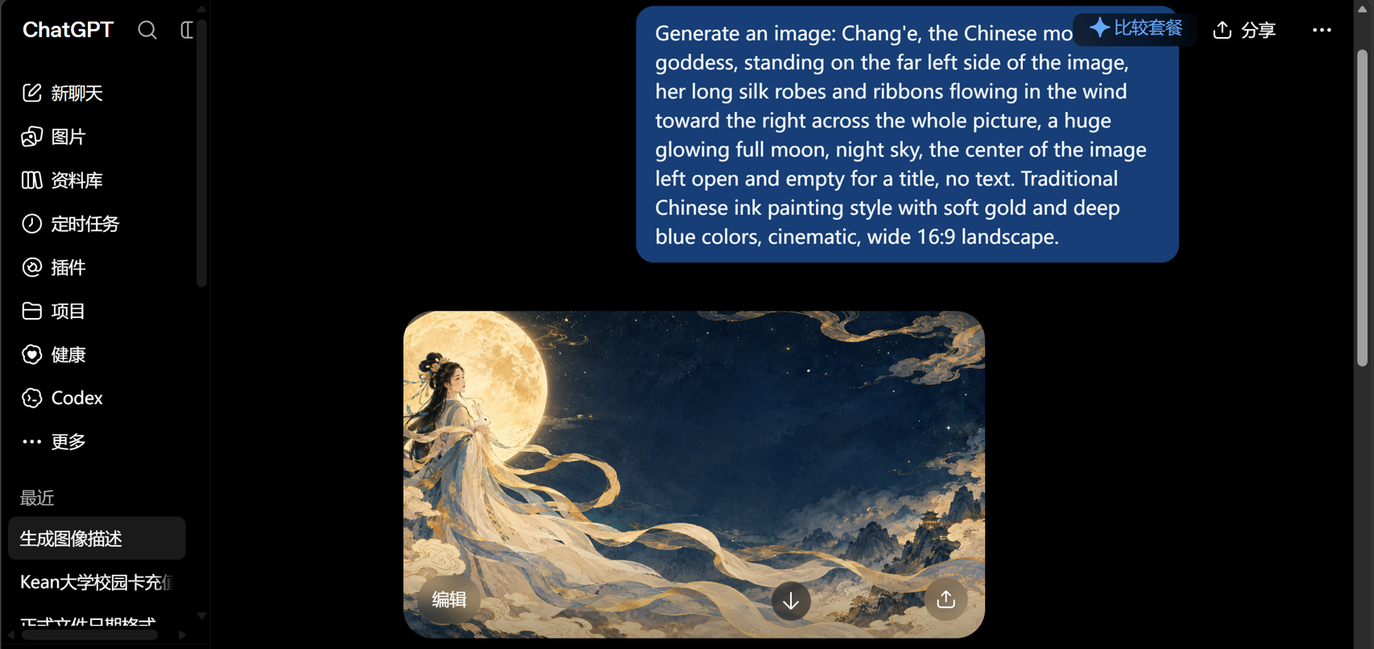
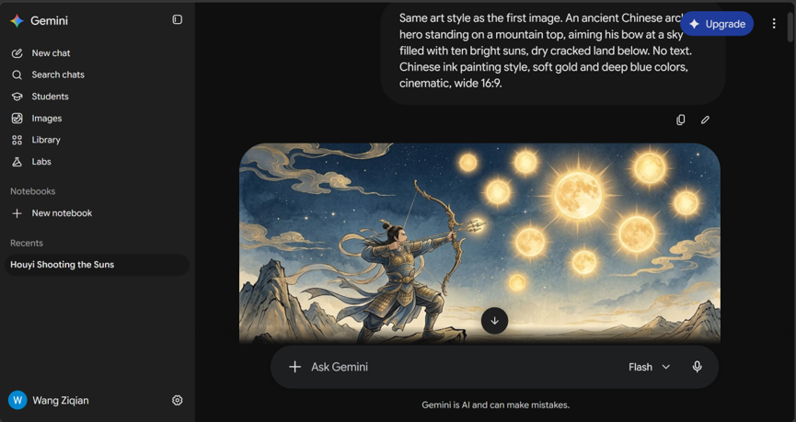
ChatGPT had an error, so I switched to Gemini
MAKING THE PICTURES
ChatGPT: the cover
Gemini: the other nine pictures
Same style words in every prompt: "Chinese ink painting style, soft gold and deep blue colors"
Notes:
For the pictures, I first used ChatGPT. I asked for Chang'e on the left, with her dress flying to the right, and space in the middle for the title. That became my cover. But after the first picture, ChatGPT gave an error. So I switched to Google Gemini and made the other nine pictures. I used the same style words in every prompt, like "Chinese ink painting" and "gold and deep blue", so all the pictures look like one set.

Slide 12
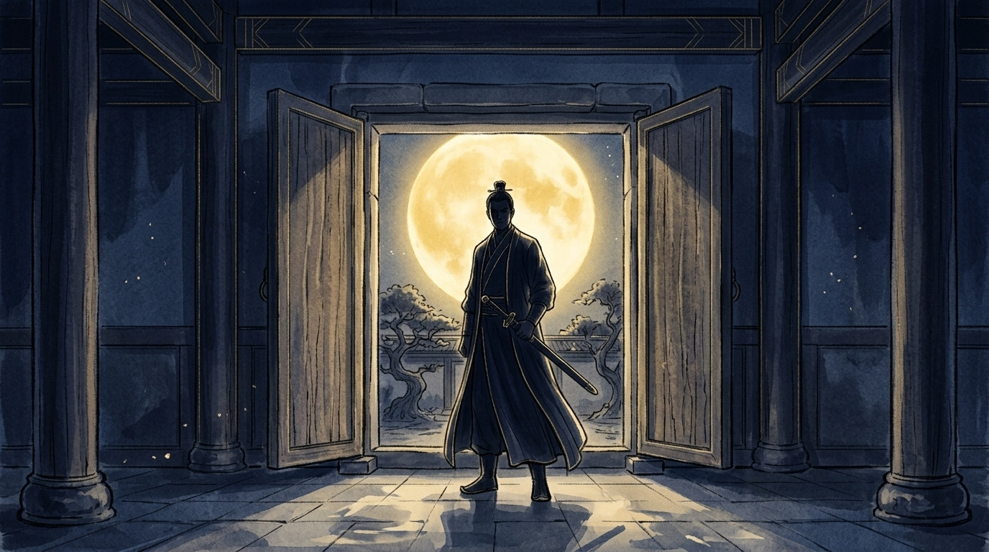
Thank you
Notes:
AI helped me with ideas, code, and pictures. But I made the choices and put everything together. Thank you for listening!

